Slide 1
IS113
Web Application Development I
Trial Lab Test
Set A
Walk Through
1

Slide 2
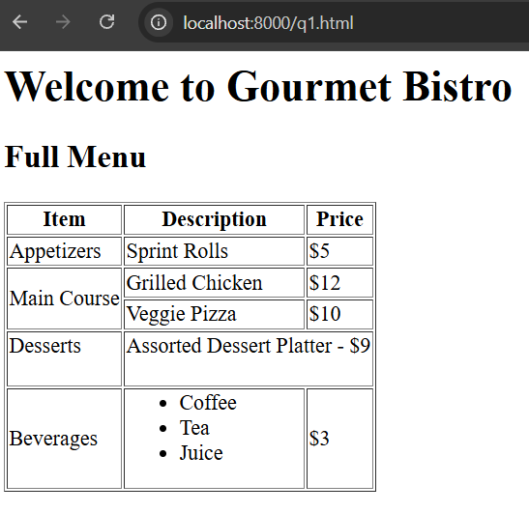
Q1
q1.html
node_modules, package.json, package-lock.json, are provided.
> nodemon server.js
Web browser: localhost:8000/q1.html
rowspan
colspan,
<br><br>
<ul></ul>,<li></li>
within <td></td>
2

Slide 3
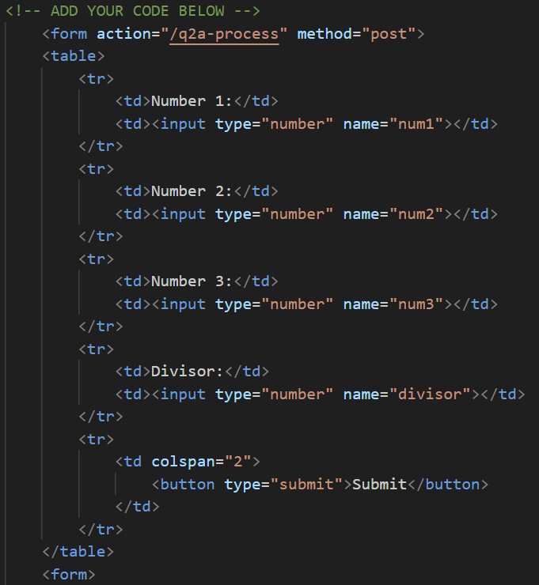
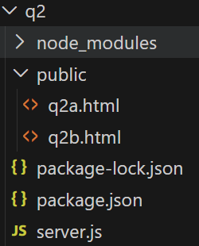
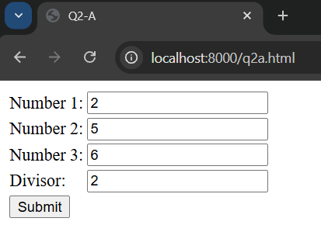
Q2a
The form submits the data via POST to the /q2a-process route, which is handled by q2a-process.js
These will be numbers.
<input type=“number”>
q2a.html
3
3
q2a.html

Slide 4
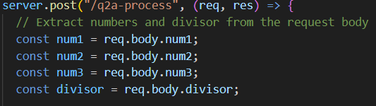
Q2a
The form submits the data via POST to the /q2a-process path
q2a.html
server.js
4

Slide 5
Q2a
function called isDivisibleBy(num, divisor) returning a value as Boolean.
Printing out as an unordered list using res.send("....."). Tags <ul></ul>, <li></li>
Validations:
The question did not ask to output error messages
Do not need to handle this case.
Possible solutions
Using an array to loop through the 3 numbers. With results in another array.
Use { key: <num>, result: <YES/NO> } for each number in an array.
Individually checked (x3).
5

Slide 6
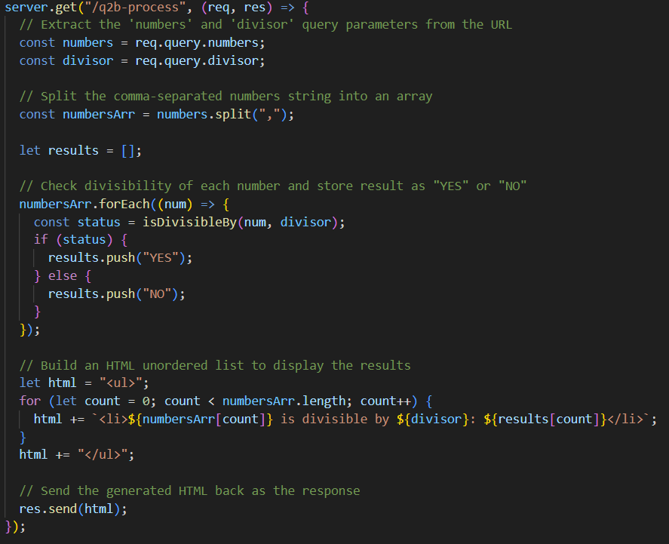
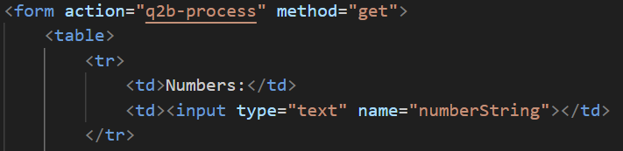
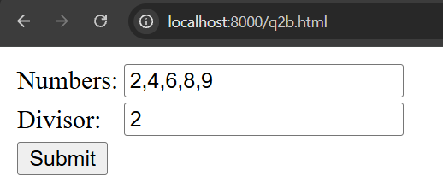
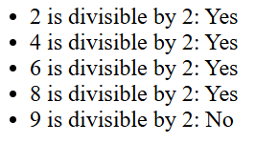
Q2b
Include an HTML form that submits data to the /q2b-process route using the GET method.
String.prototype.split()
Reuse the function isDivisibleBy(num, divisor) that returns a Boolean value.
6

Slide 7
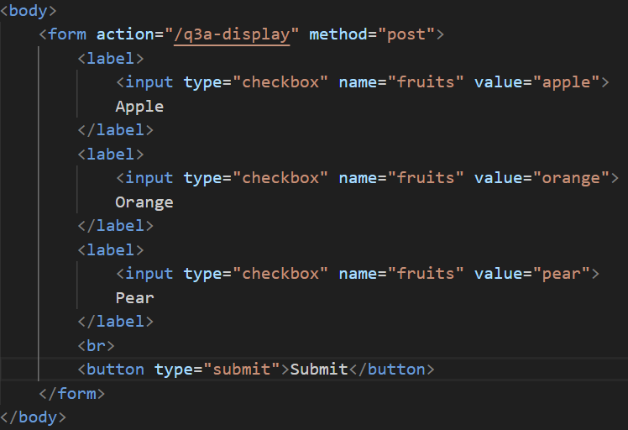
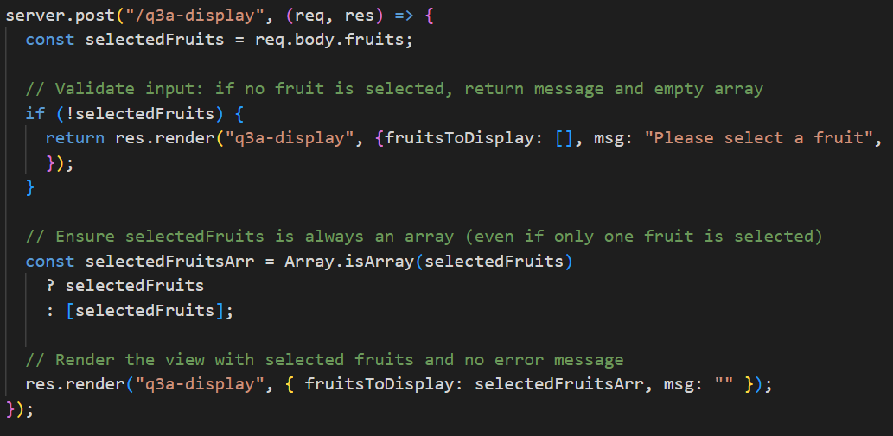
Q3a
Users select fruits on one page (q3a-form.html), and their selections are displayed with images on a separate results page (q3a-display.ejs).
q3a-form.html
Use POST
Checks if the user selects 1, more than 1 or none.
Send the selected fruit array and messages (if any) to q3a-display.ejs
server.js
7

Slide 8
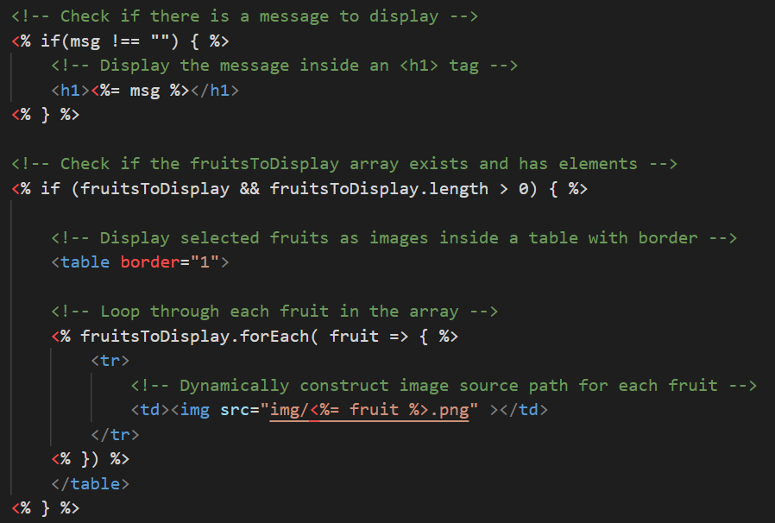
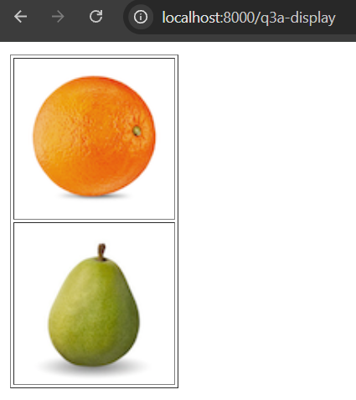
Q3a
2 res.render() calls were used to send different data — specifically the fruitsToDisplay and msg properties to the same q3a-display.ejs file, depending on the user’s selection.
server.js
q3a-display.ejs
8

Slide 9
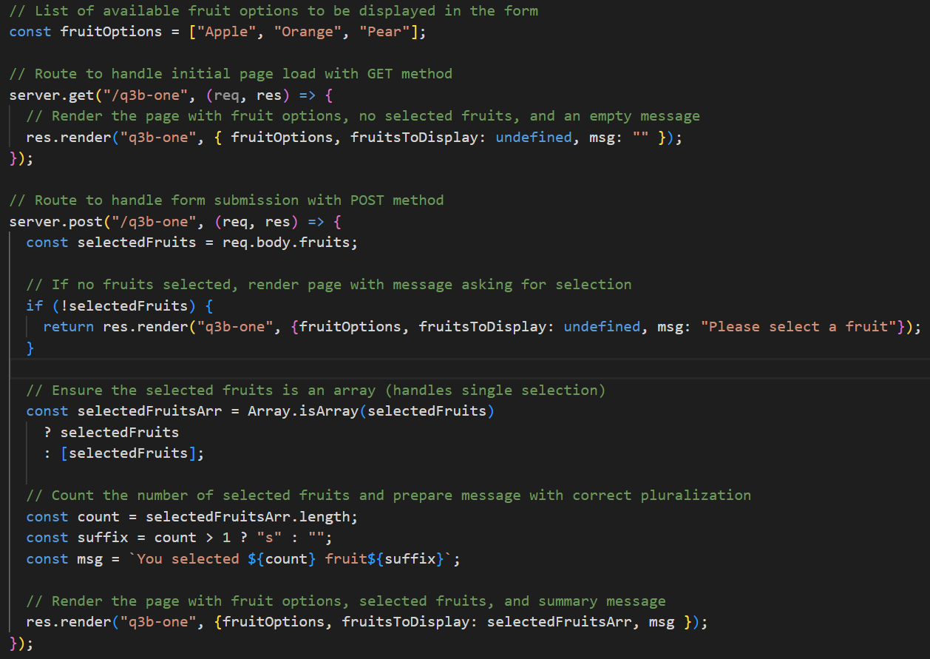
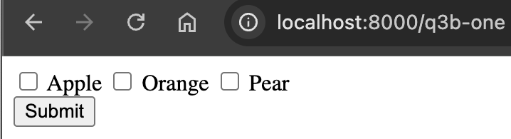
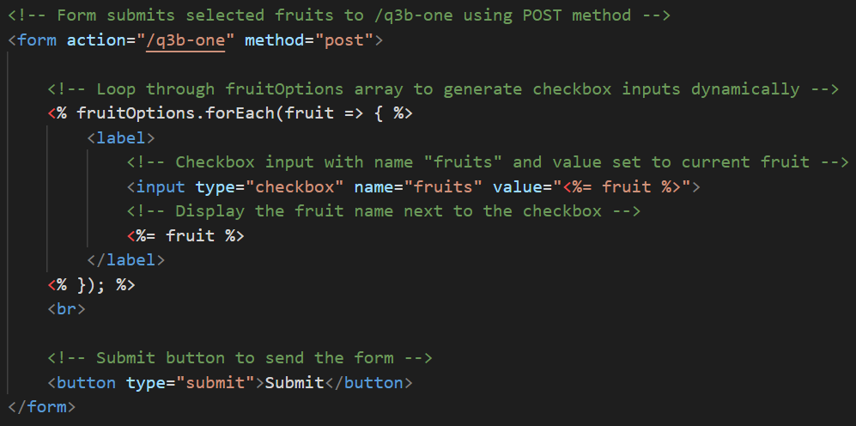
Q3b
When the form is first load.
server.js
part of q3b-one.ejs
9

Slide 10
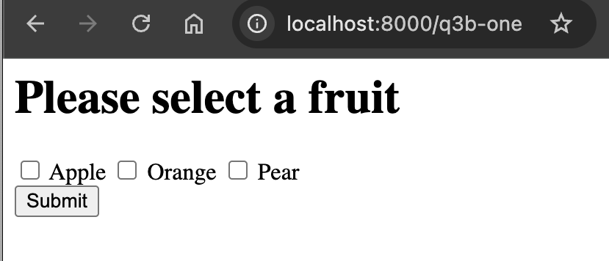
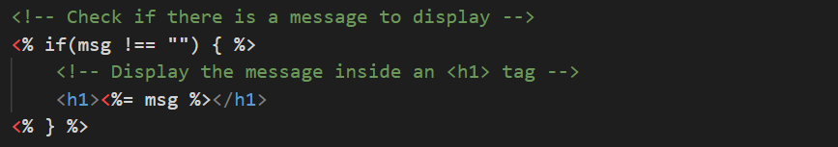
Q3b
When the form is submitted without selection.
part of q3b-one.ejs
server.js
10

Slide 11
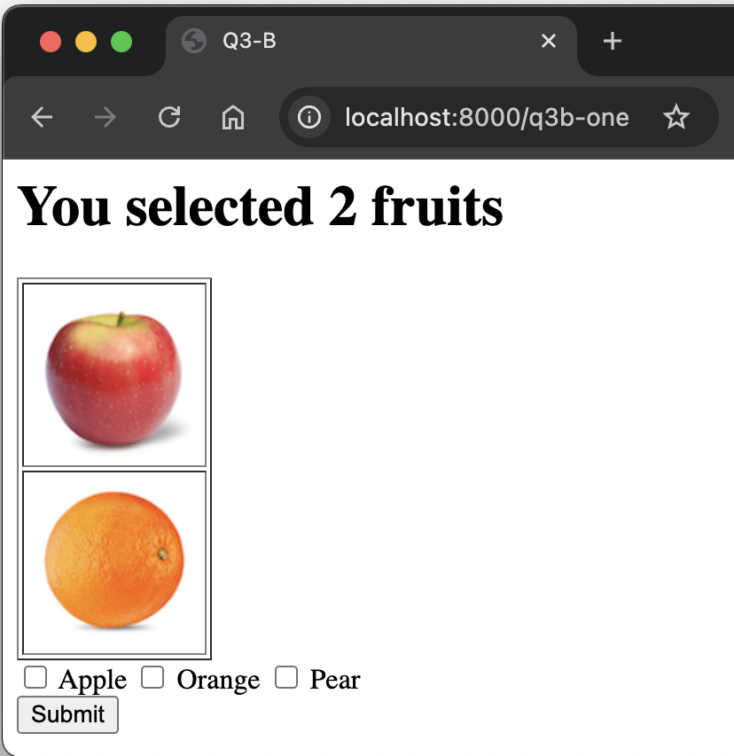
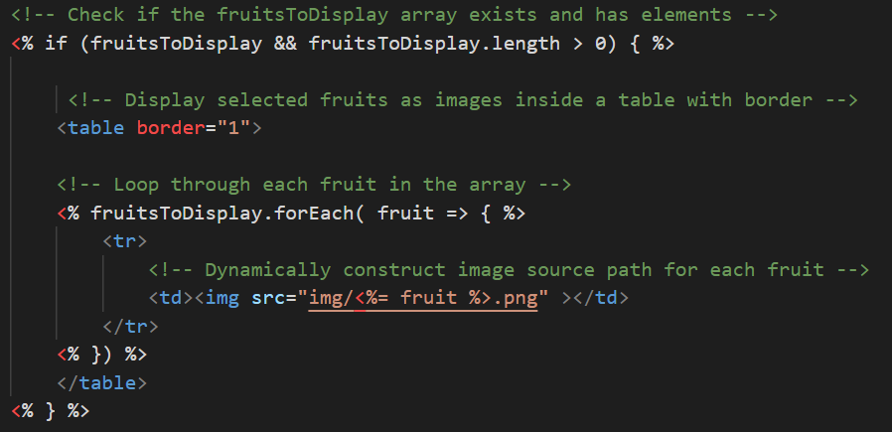
Q3b
When the form is submitted at least 1 selection.
part of q3b-one.ejs
server.js
11

Slide 12
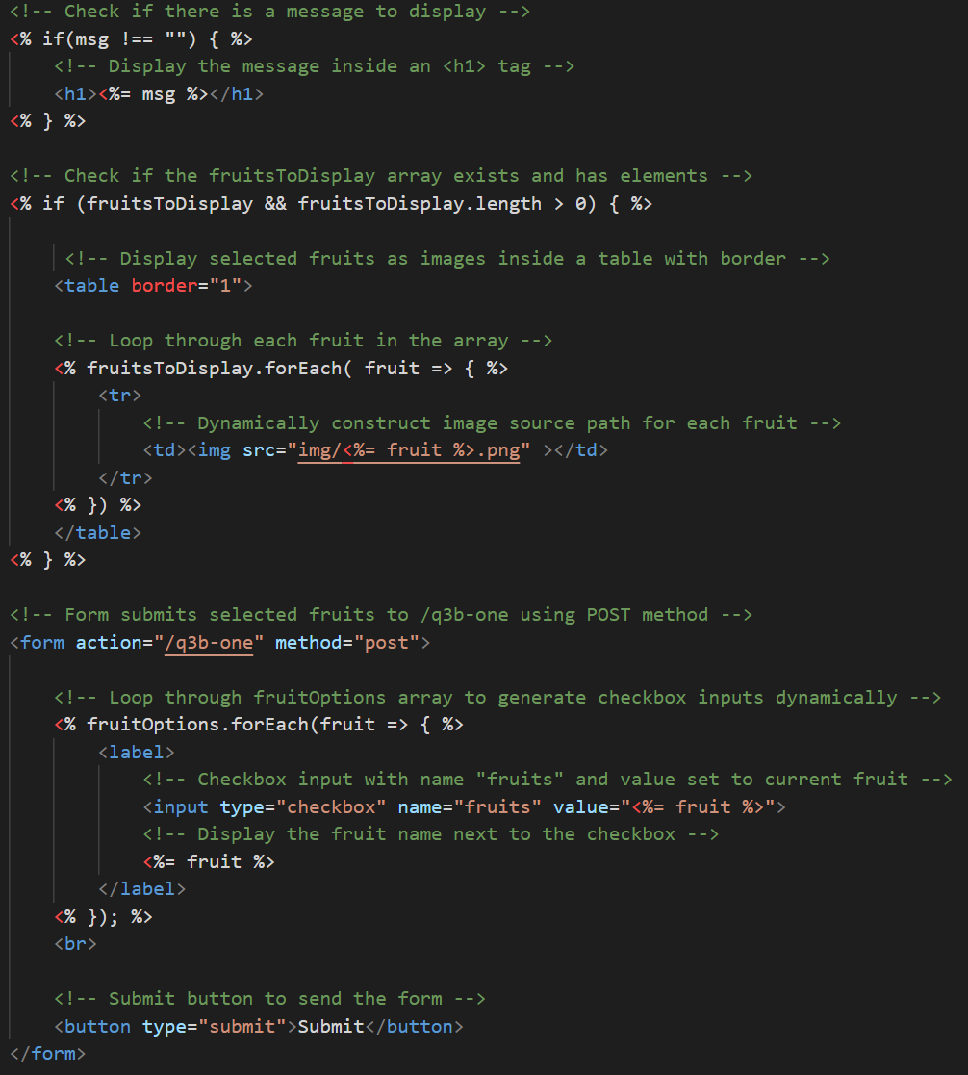
Q3b
complete q3b-one.ejs
12

Slide 13
Q4
Likely to be marked via test cases.
Code has to be within the function
Logic-driven, with or without UI.
Convert all to upper or lower cases.
Check if the number of unique characters for the two strings are the same
Check if the number of occurrences of each unique character in the two strings are similar.
13

Slide 14
IS113
Web Application Development I
Trial Lab Test
Set A
14

Slide 15
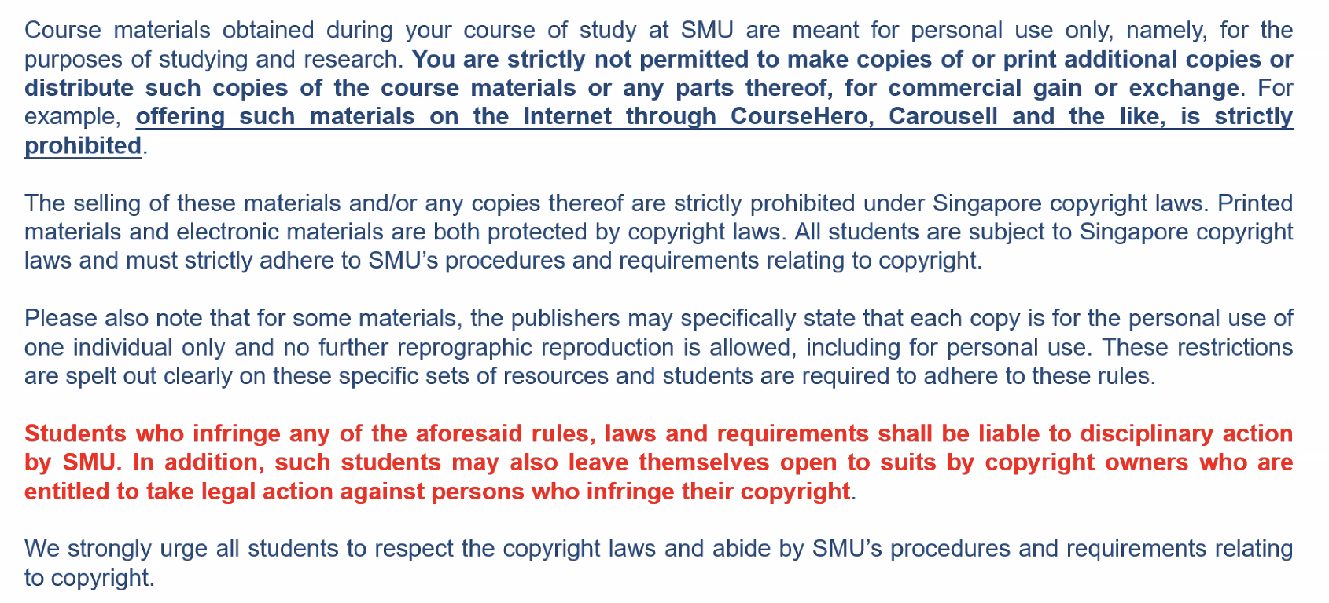
15

